Slide 1
Flight Forecast
Predicting Cancellations and Delays out of Chicago

Slide 2





Problem
Airlines have no incentive to provide accurate flight delay information
This app gives the user the power to make an educated decision when choosing their flights

Slide 3
Demo

Slide 4

Data
Data is provided by the Bureau of Transportation Statistics
Filtered to 2018 data for flights leaving from Chicago
Variables include:
Month and day of travel
Airport
Destination State
Airline

Slide 5


Algorithm
Delays
Basic linear regression
Original Goal: average residual within 10 minutes
Result: average residual within 26 minutes
(median 1.6 minutes!)
Cancellations
Logistic regression
Original Goal: Misclass rate of <20%
Result: Misclass rate of 2.2%
(with trivial solution)

Slide 6
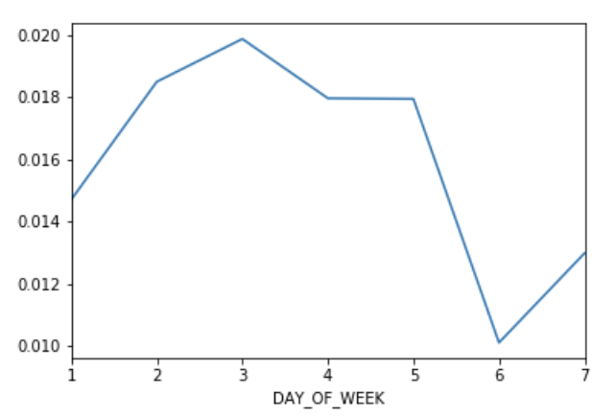

Insight
Wednesday had the highest chance of cancellations
weekends had the lowest
Flying out of Hartford CT was a nightmare in 2018
10% cancellation rate!

Slide 7
Thank You!
Questions?
Contact: TedCarlson2019@u.northwestern.edu

